Slide 1

SALES Analysis
BASED ON REGRESSION MODELS

Slide 2
OBJECTIVE
The objective of this project is to leverage machine learning regression techniques to analyze historical sales data of laptops and build a predictive model capable of forecasting future sales. This model will identify key factors influencing sales, such as product specifications (processor, RAM, storage, etc.), pricing, brand reputation, seasonal trends, and customer demographics. By accurately predicting laptop sales, businesses can optimize inventory management, adjust marketing strategies, and enhance decision-making processes for pricing and product development to meet market demand effectively.

Slide 3
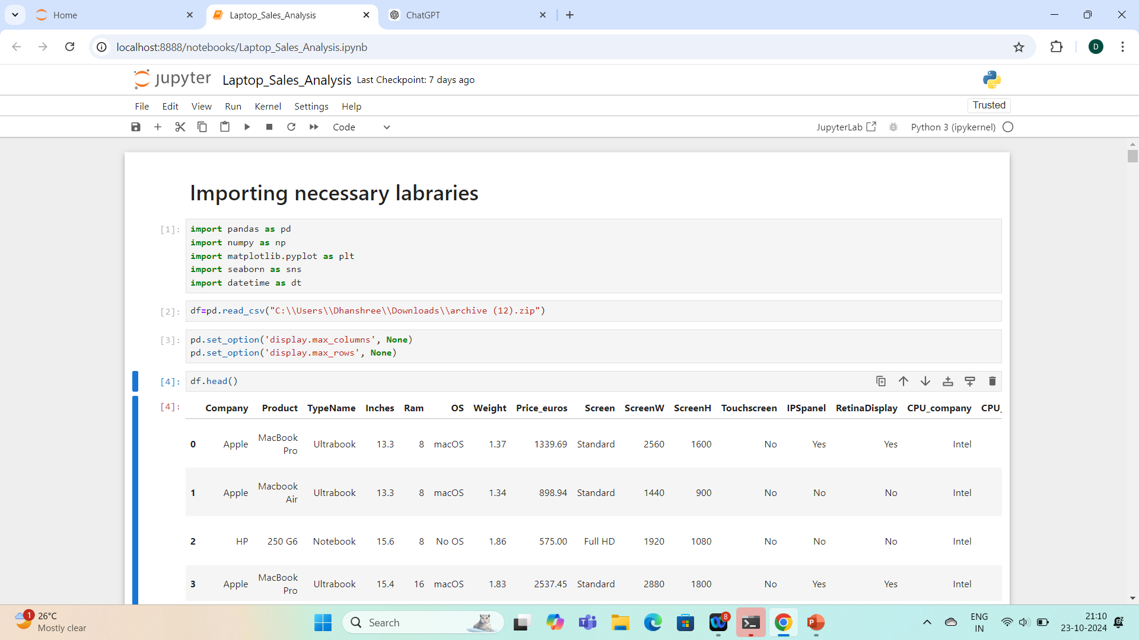
IMPORTING LABARARIES & LOAD FILE

Slide 4
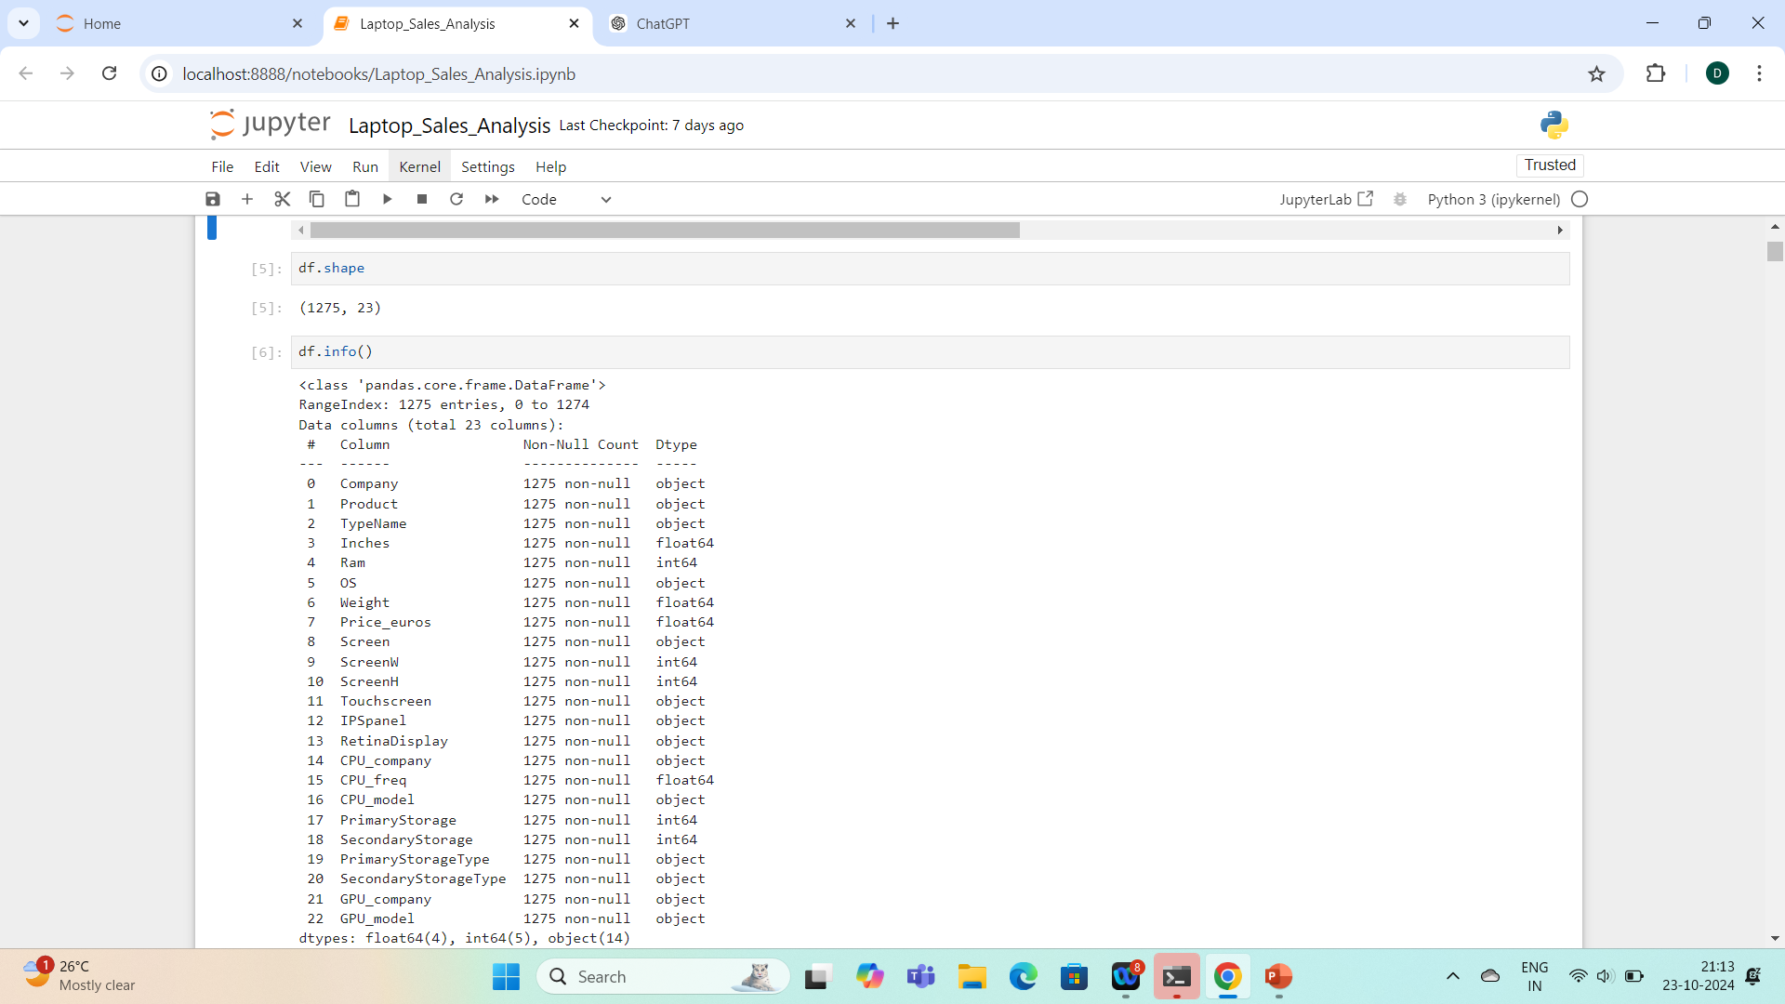
CKECKING SHAPE & INFO OF DATA

Slide 5
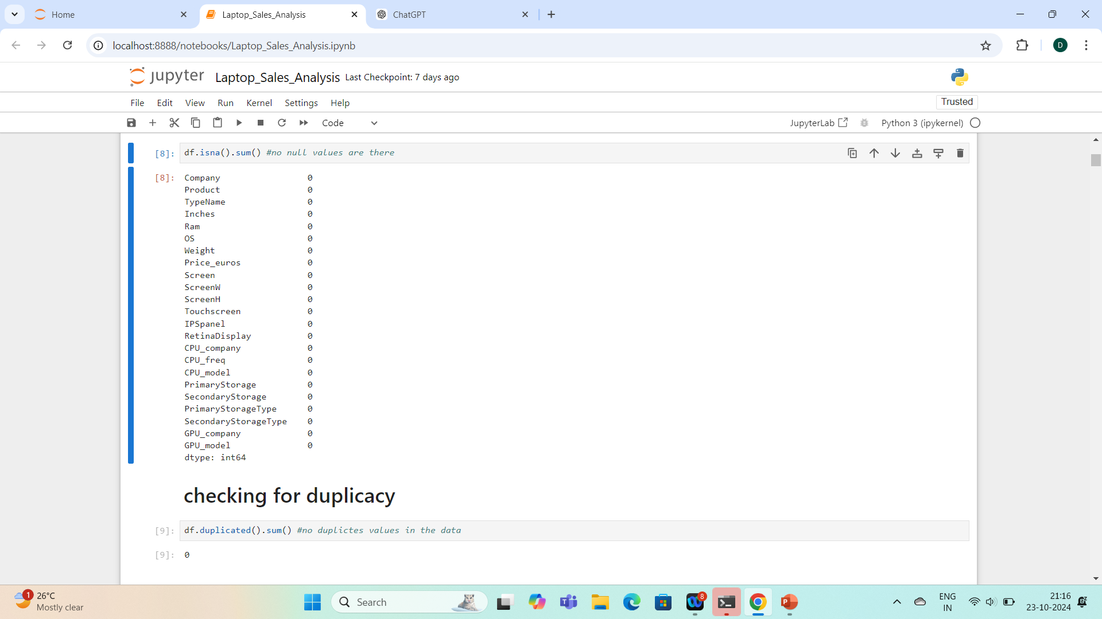
CHECKING FOR DUPLICACY & NULL VALUES

Slide 6
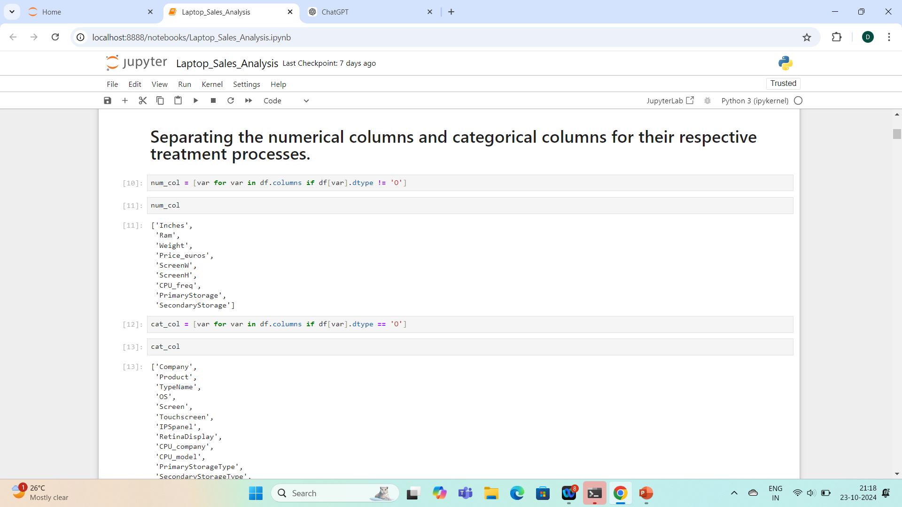
SEPARATING NUMERICAL & CATEGORICAL COLUMNS

Slide 7
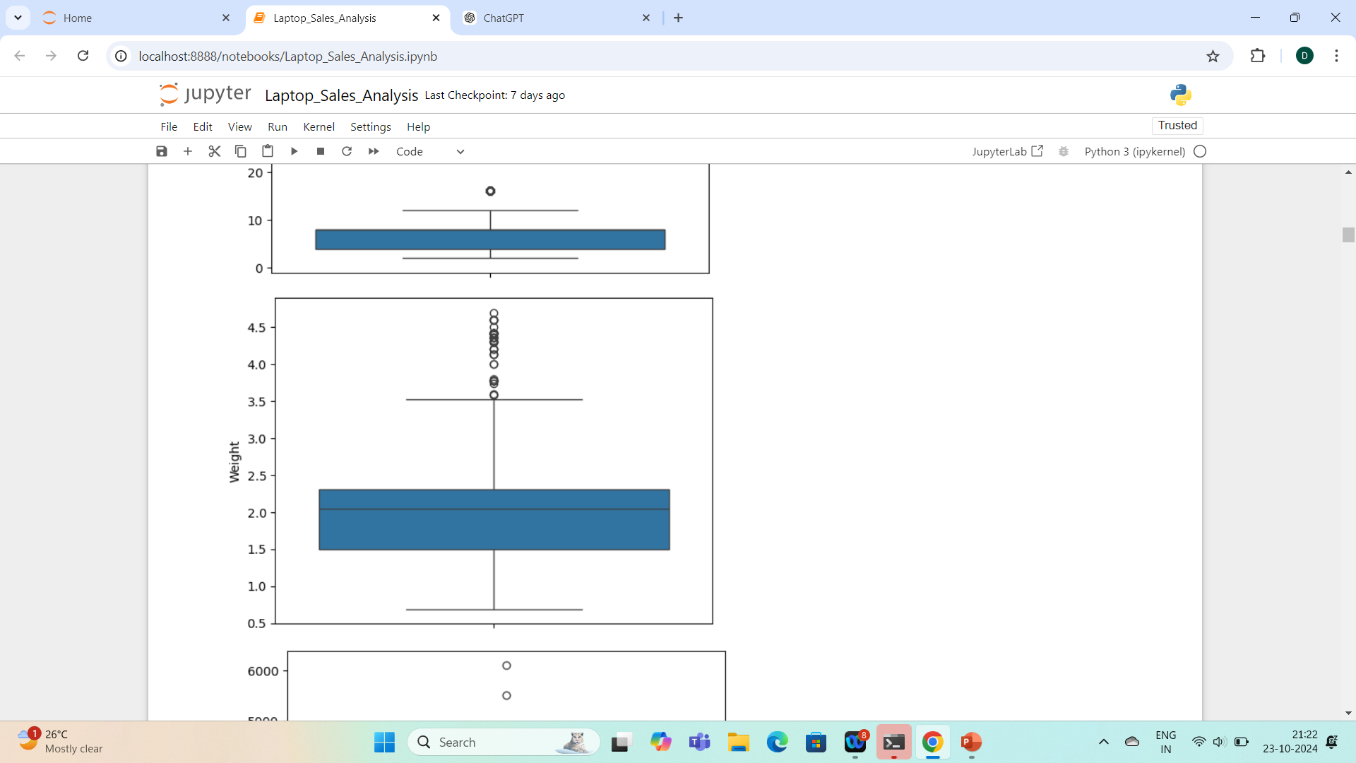
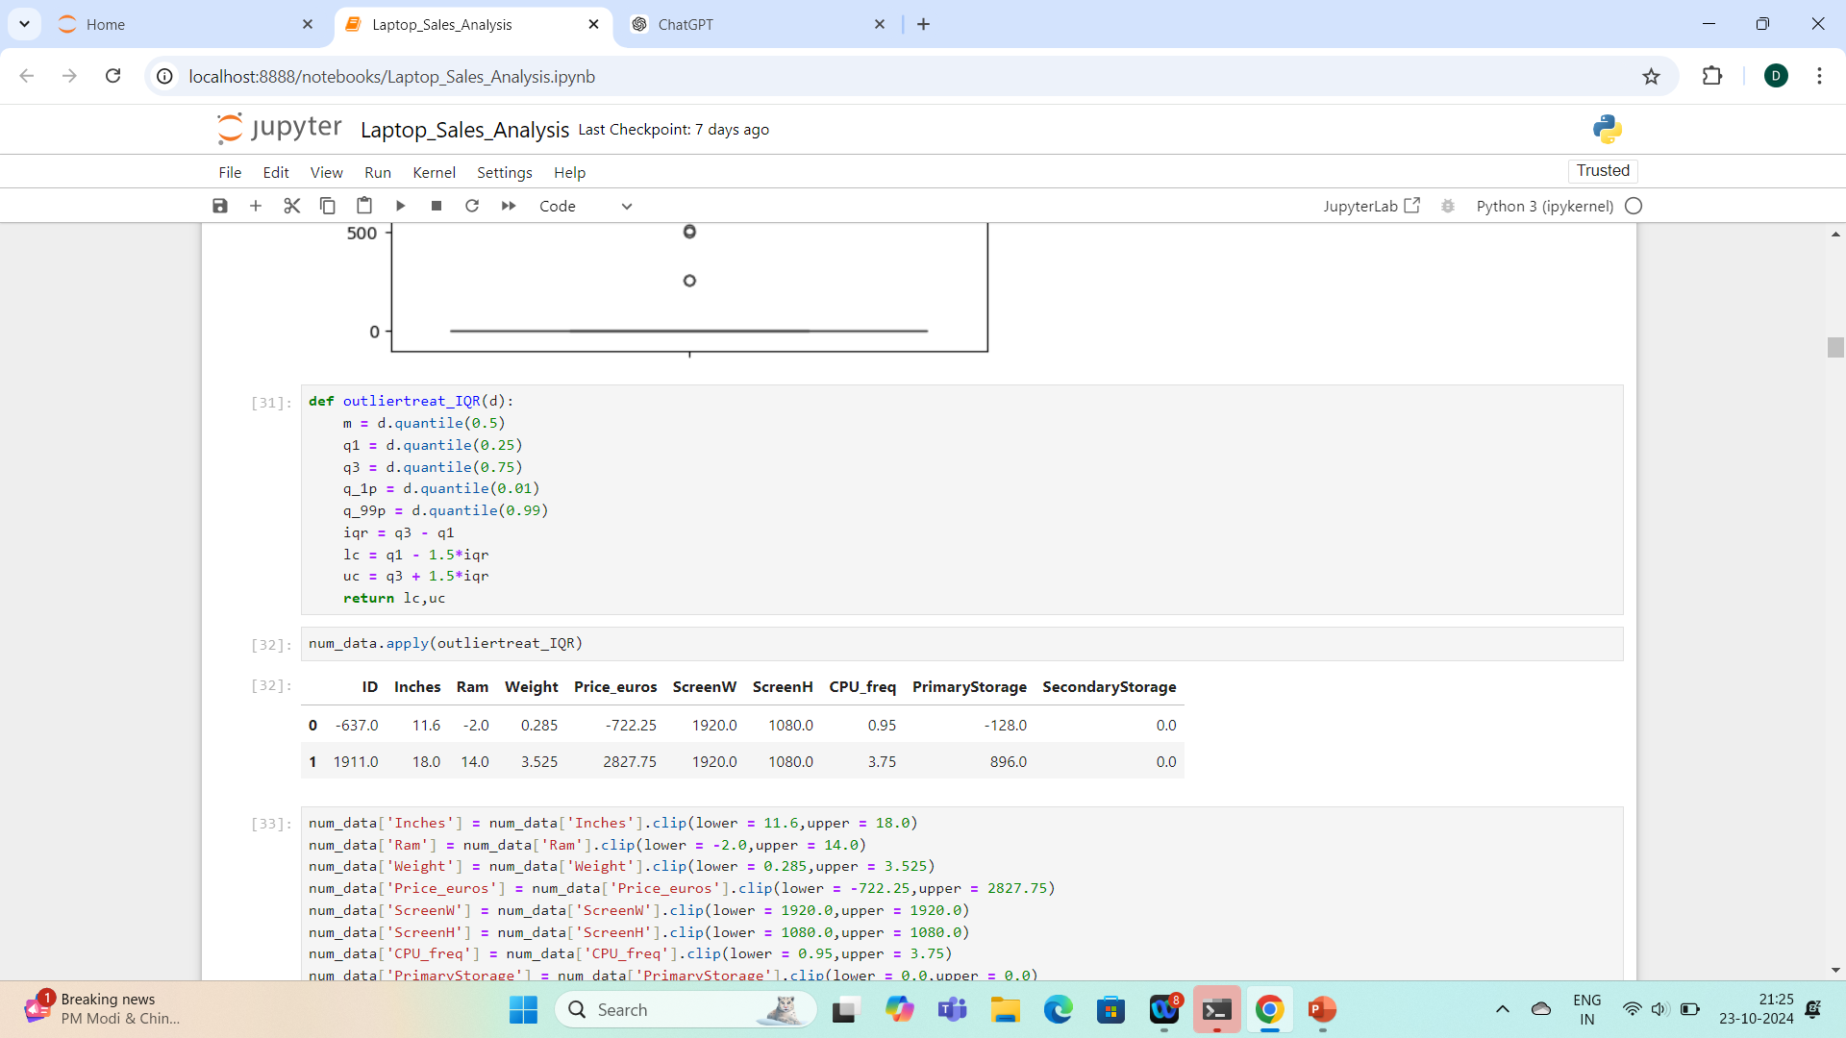
OUTLIER DETECTION & TREATMENT

Slide 8
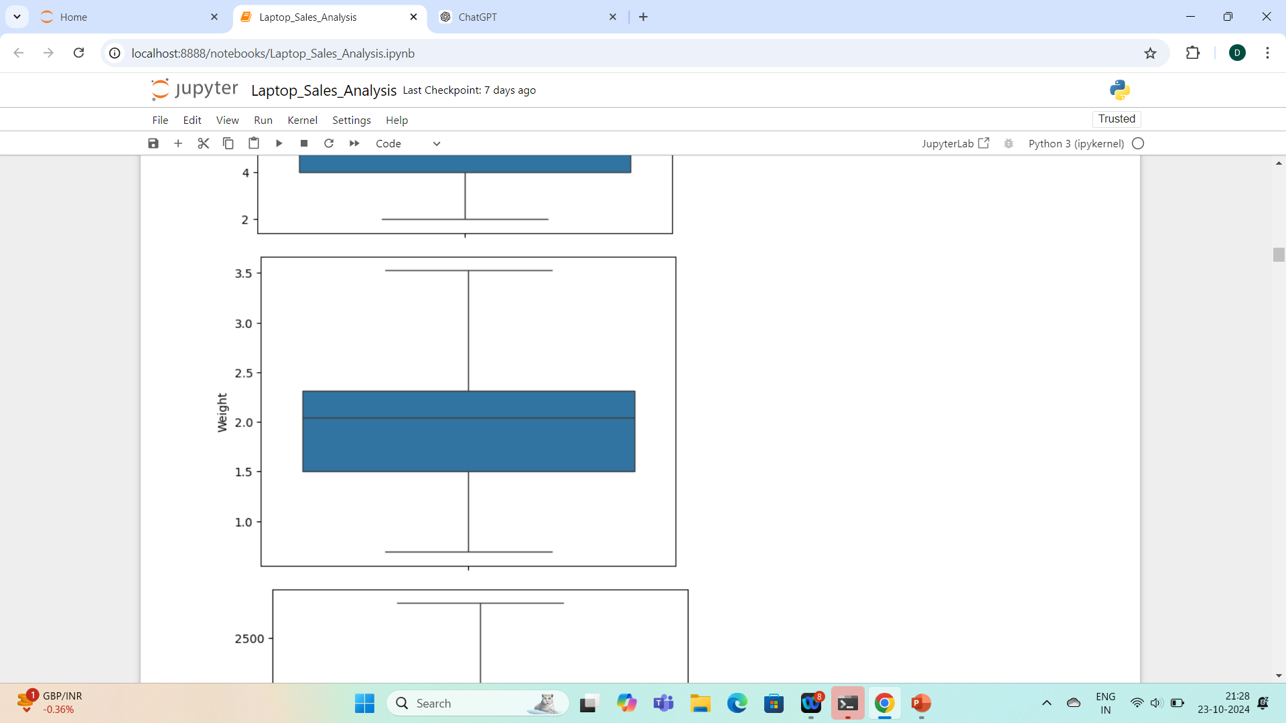
AFTER CLIPICKING THE OUTLIERS

Slide 9
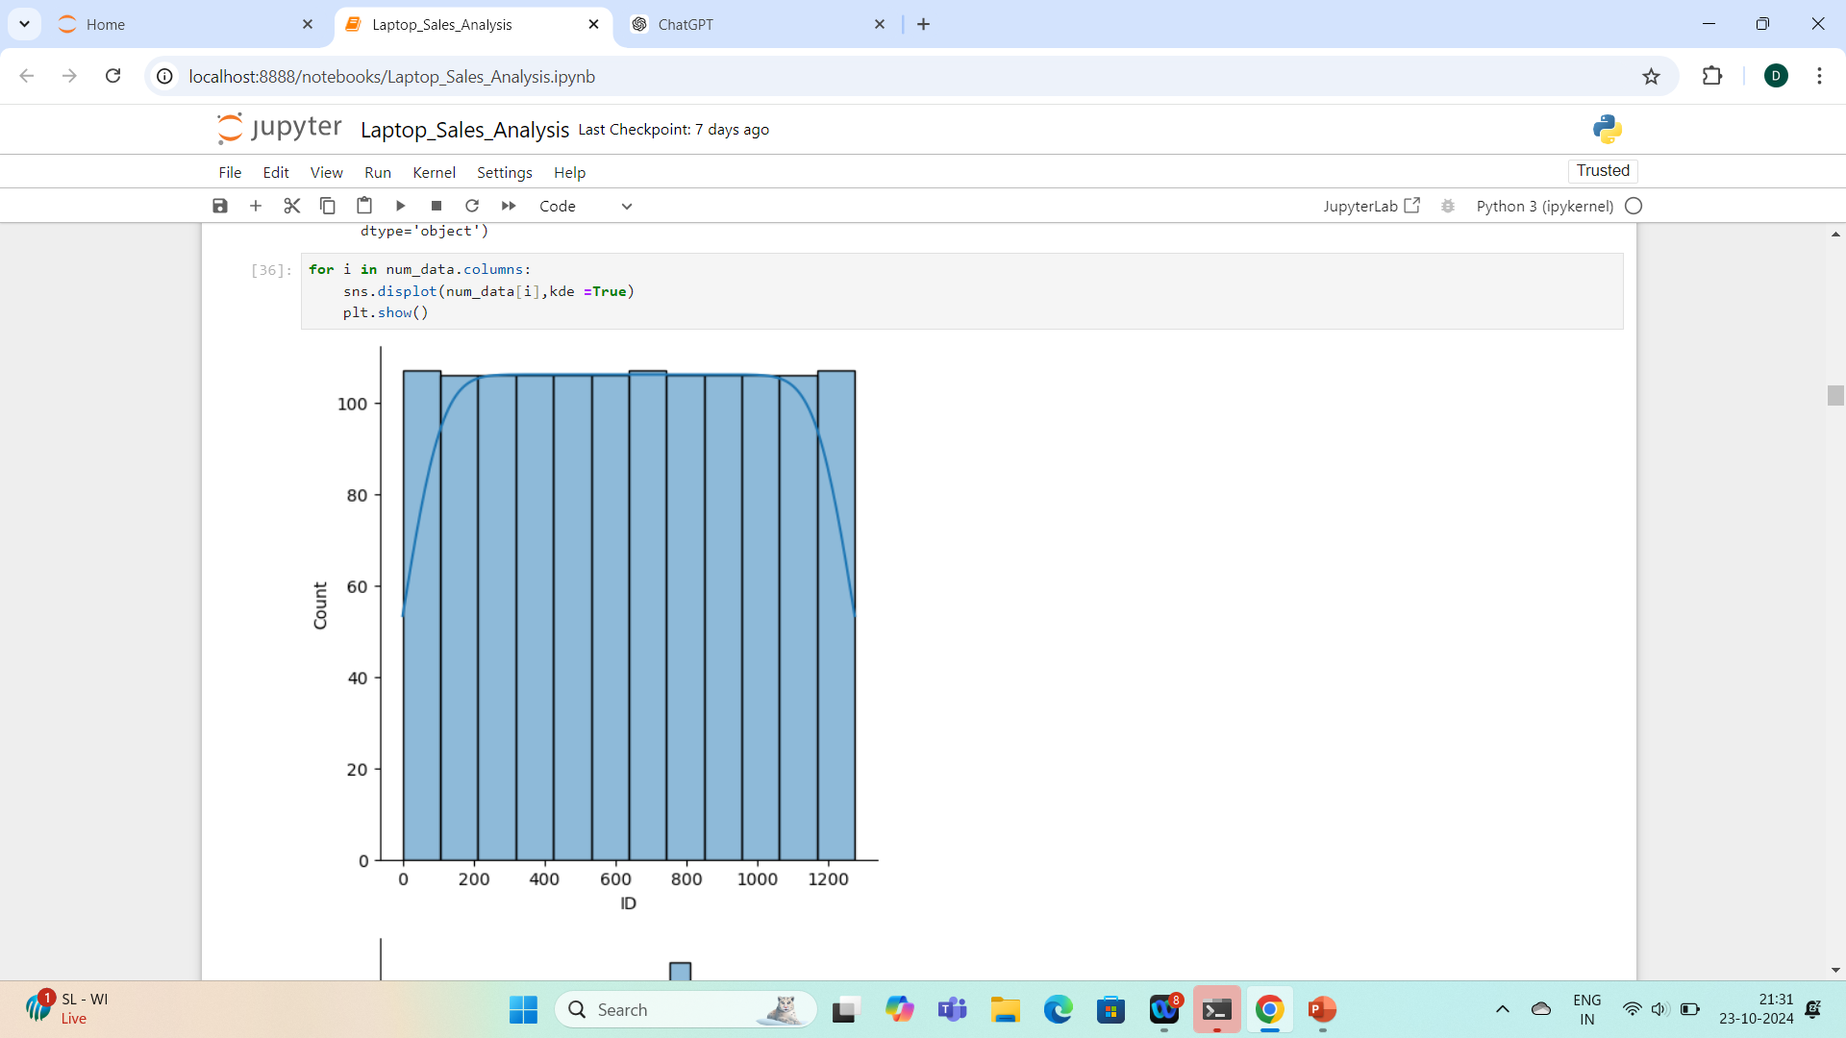
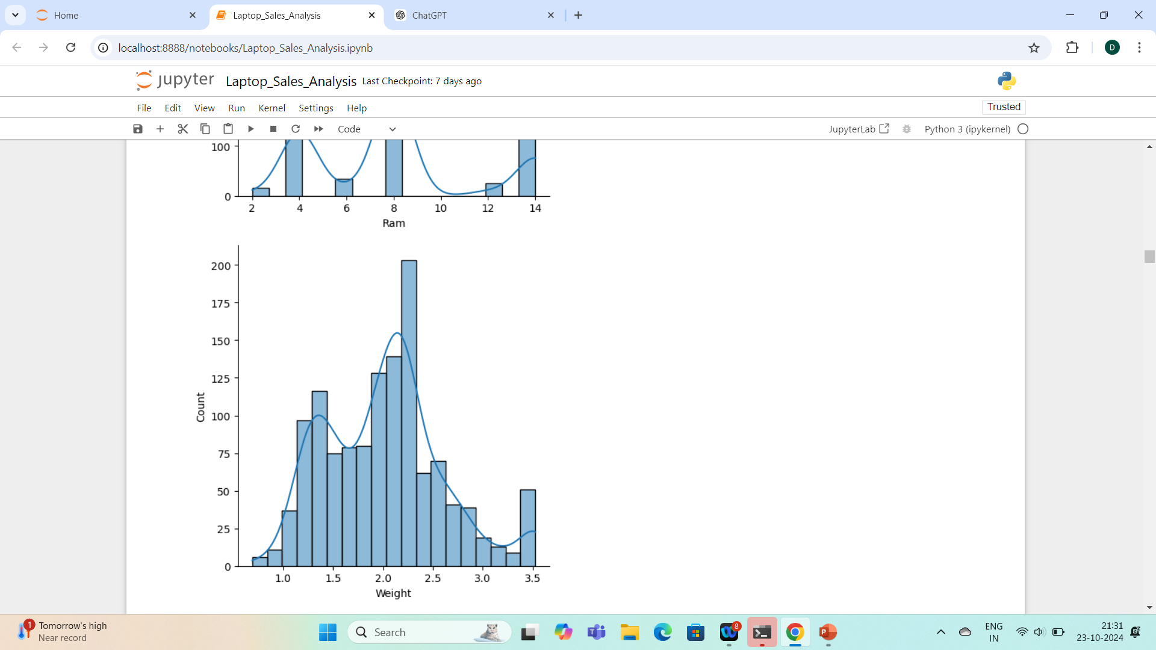
CHECKING FOR NORMAL DISTRIBUTION

Slide 10
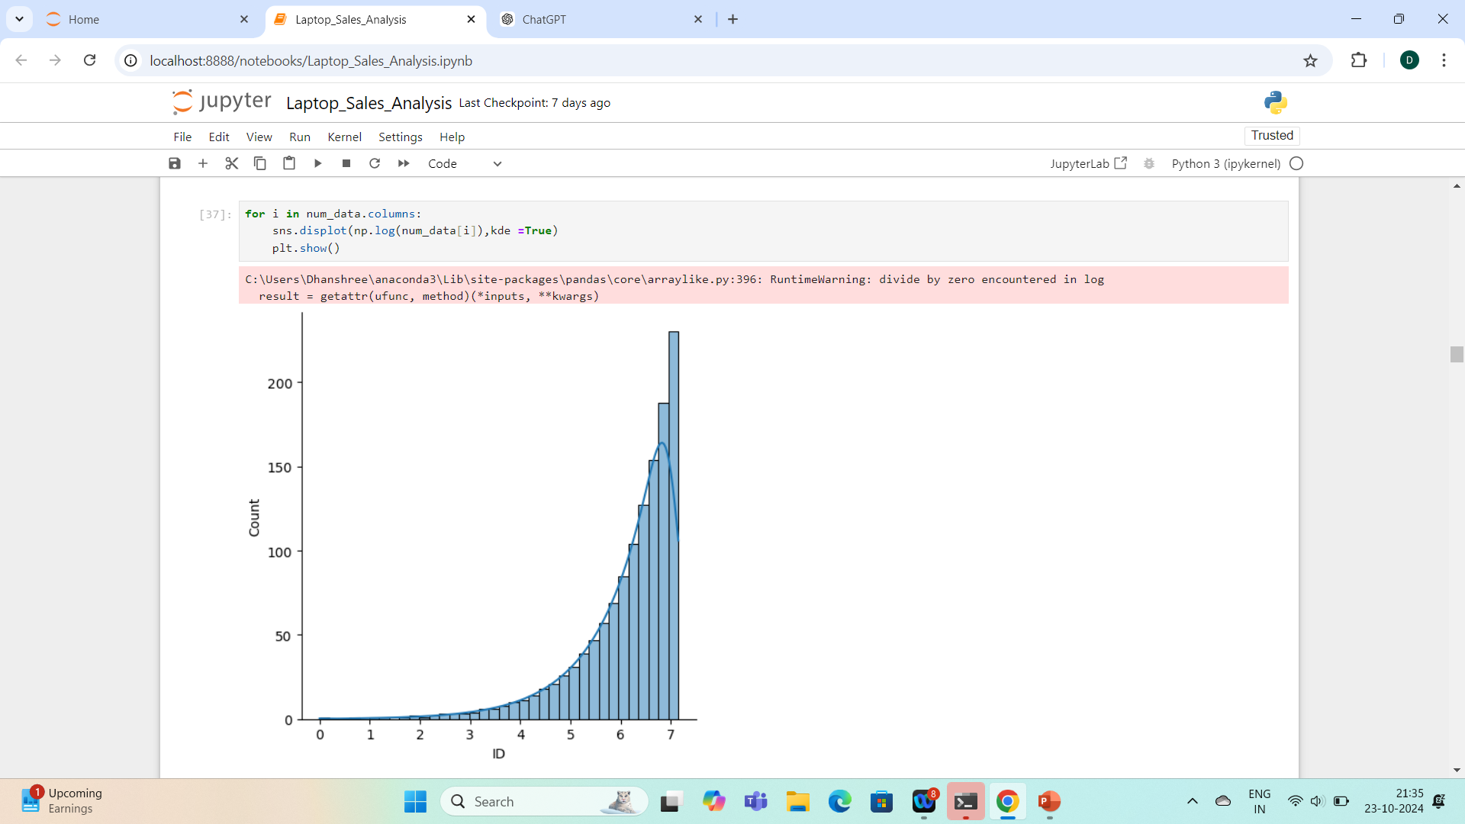
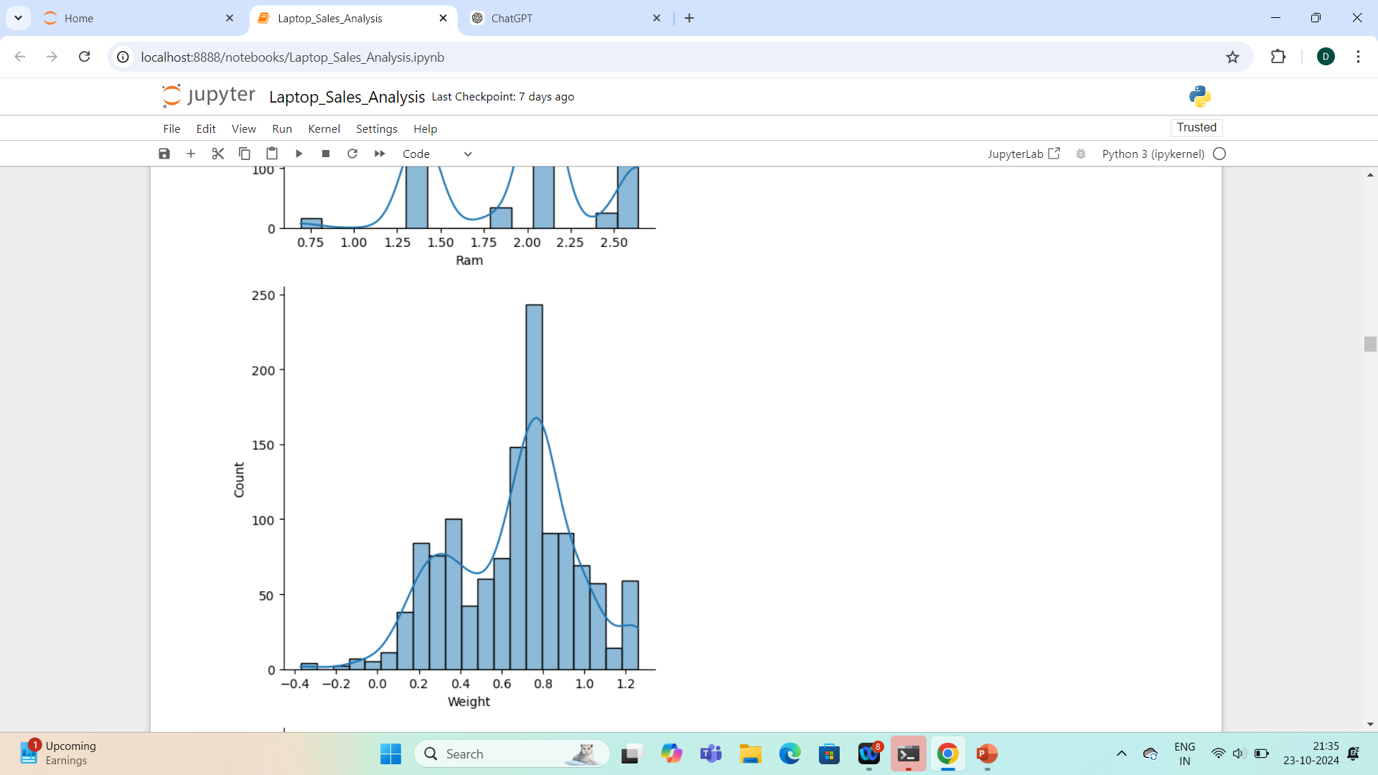
USING LOGARITHMIC TRANSFORMATION

Slide 11
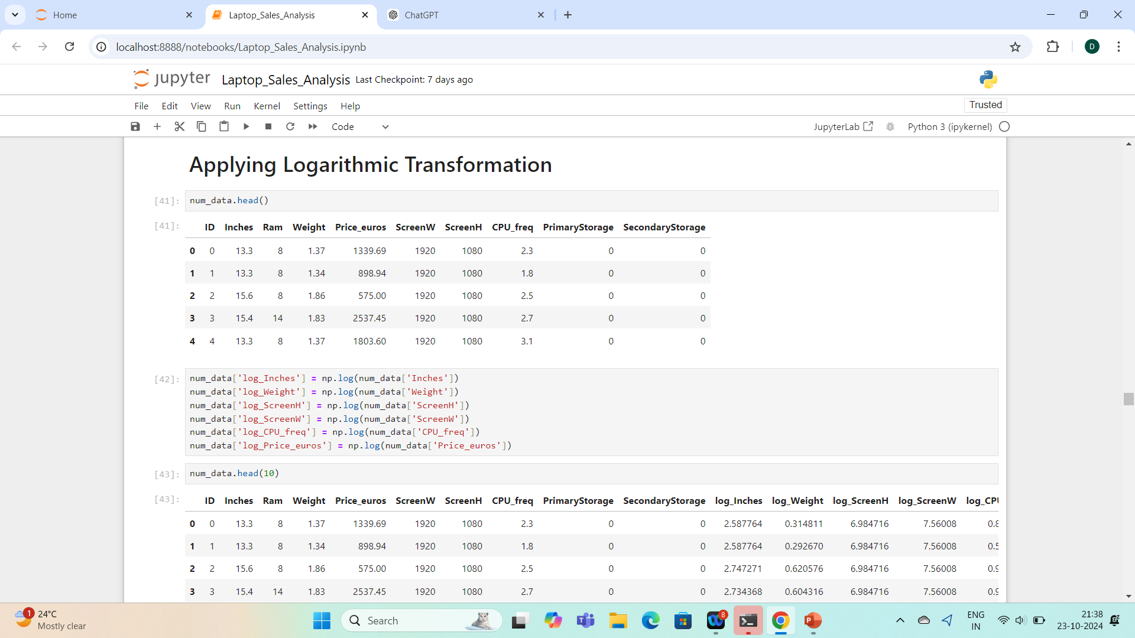
APPLYING LOGARITHMIC TRANSFORMATION

Slide 12
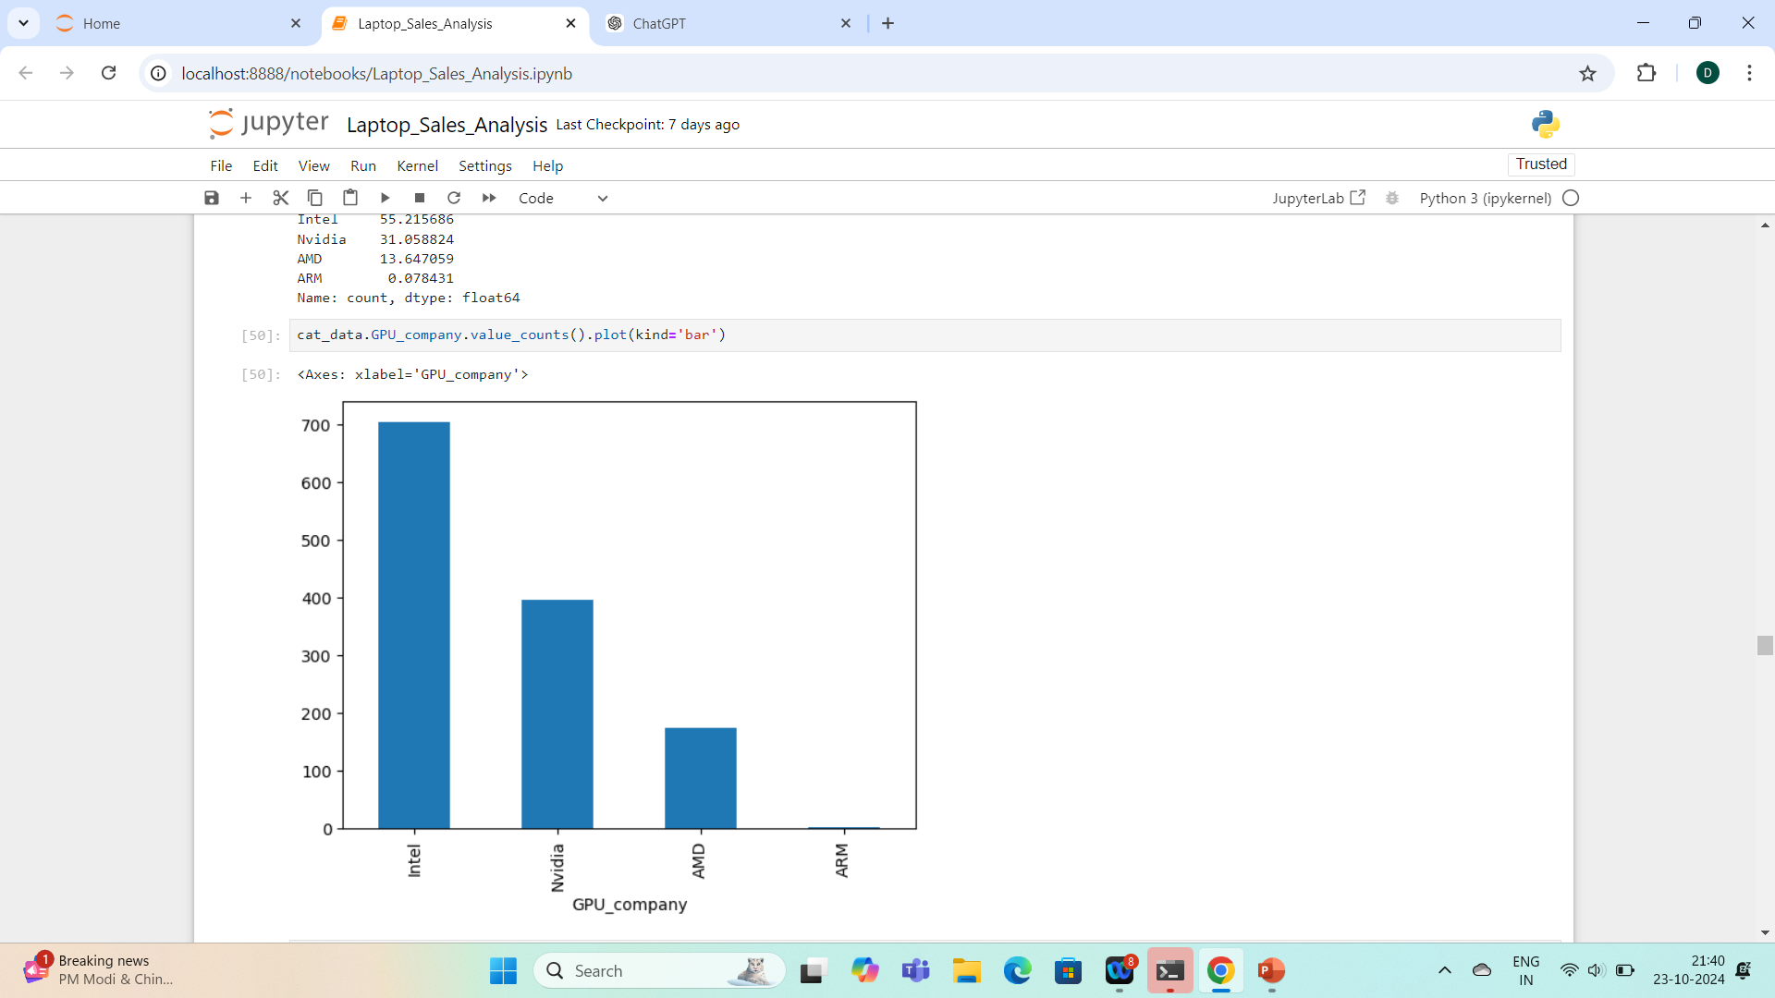
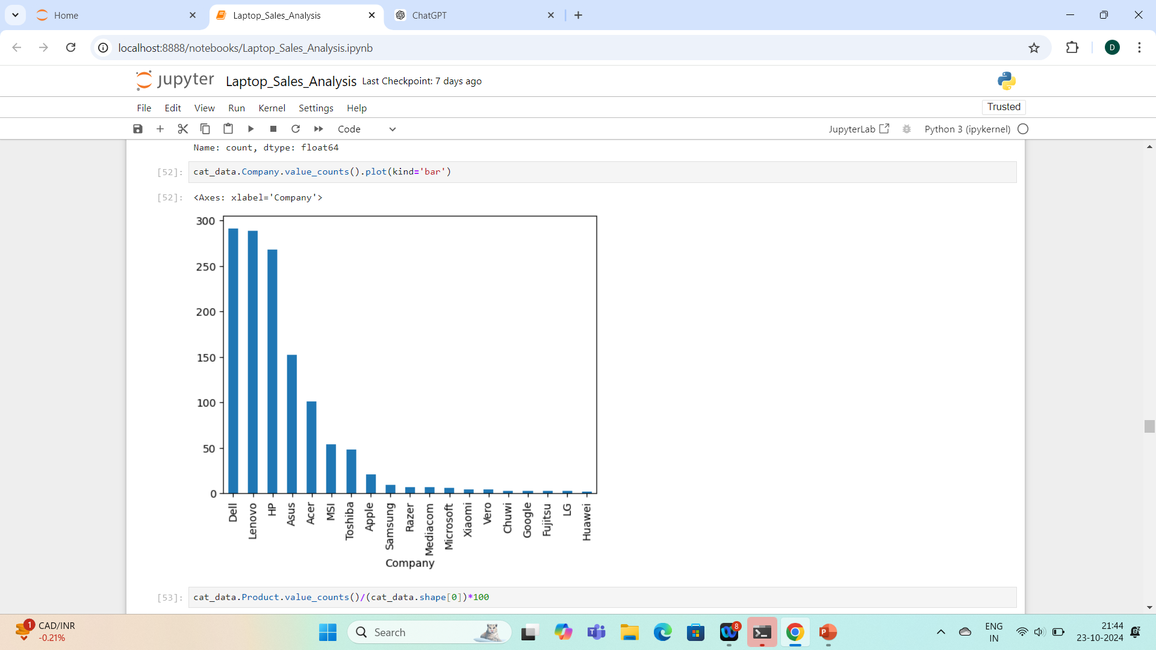
CHECKING VALUE COUNTS

Slide 13
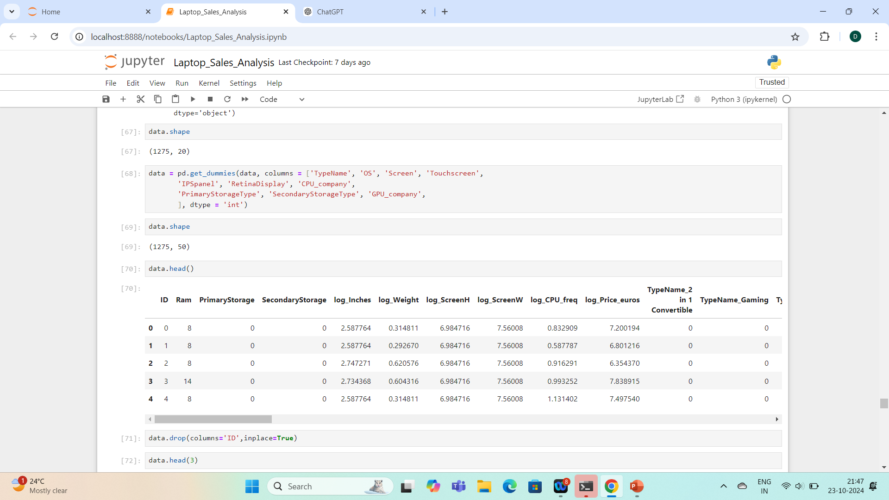
APPLYING ONE HOT ENCODER

Slide 14
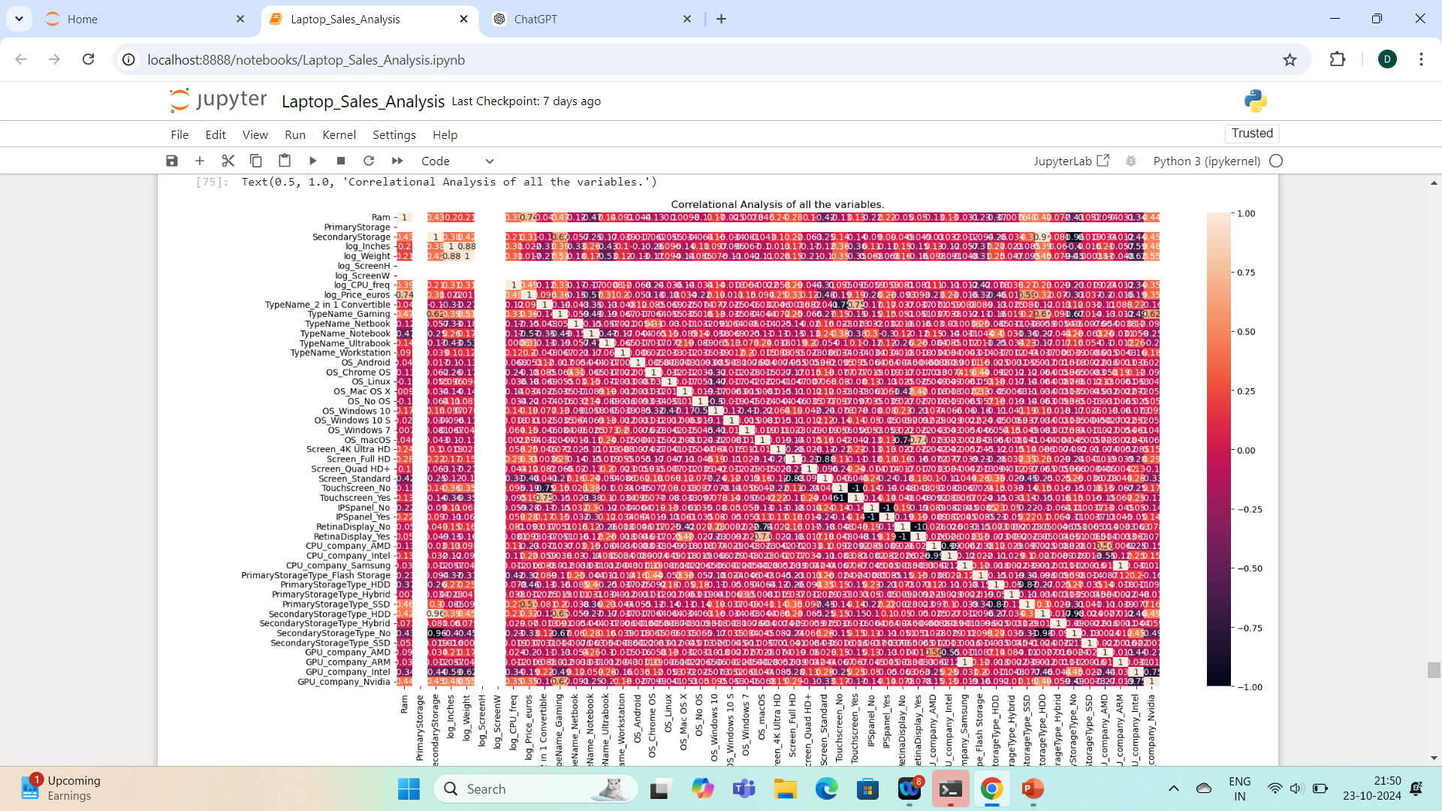
CORRELATIONAL ANALYSIS

Slide 15
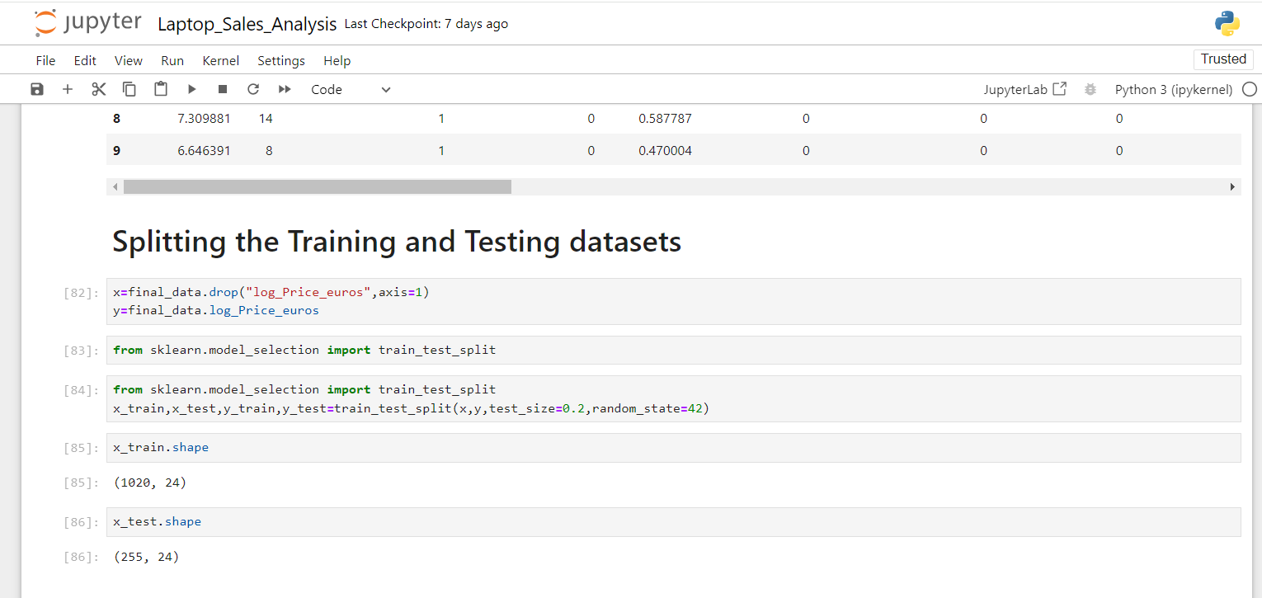
SPLITTING DATA INTO TRAINING, TESTING

Slide 16
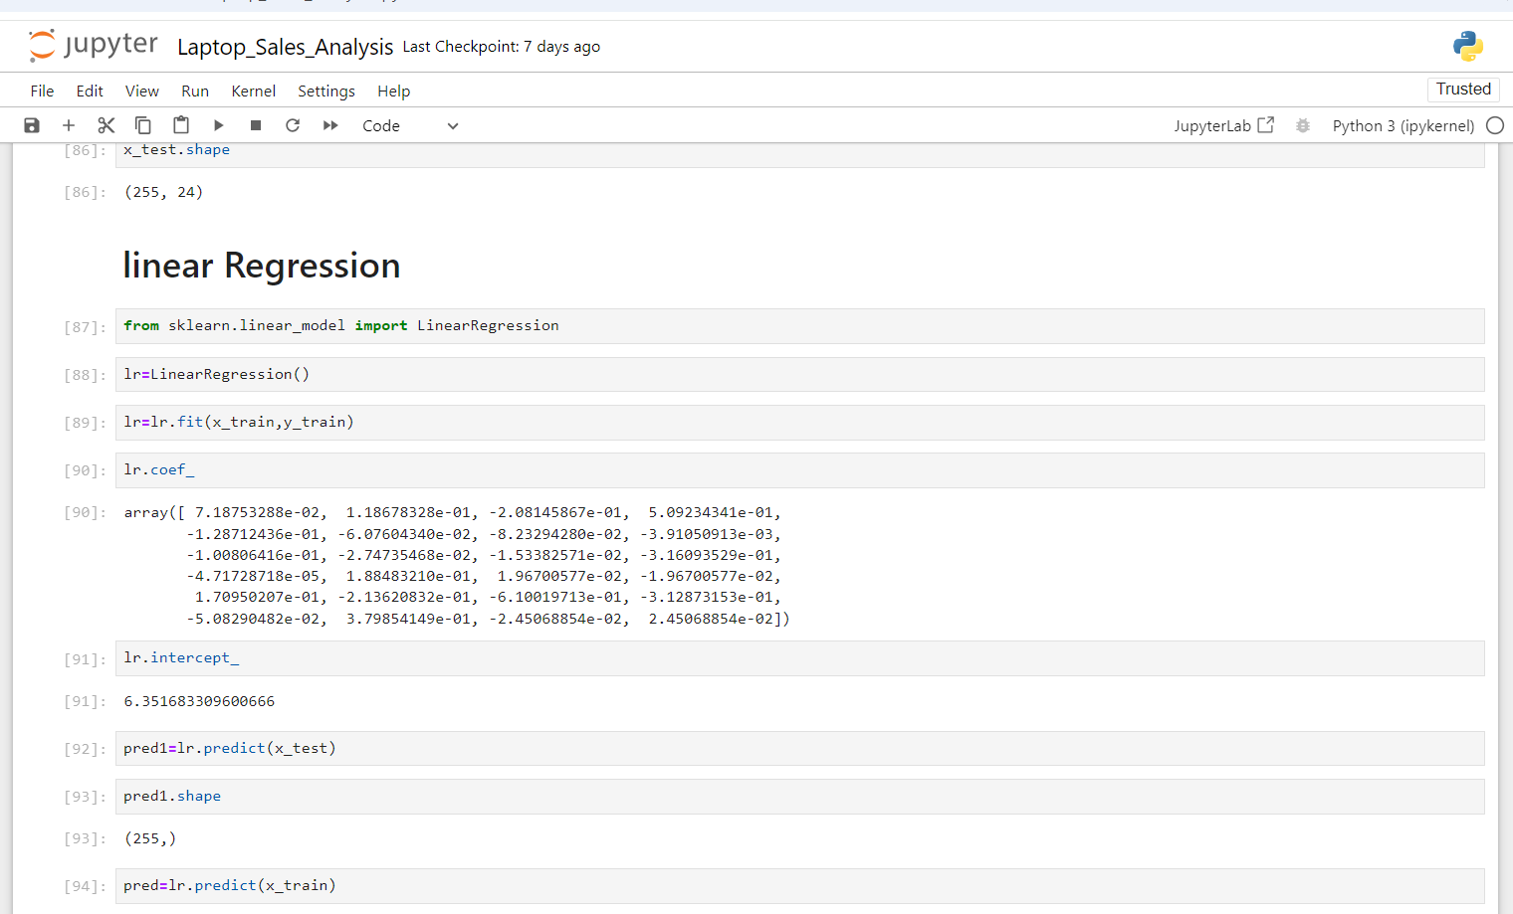
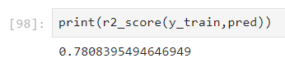
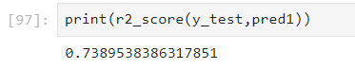
LINEAR REGRESSION
TRANING AACURACY
TESTING AACURACY

Slide 17
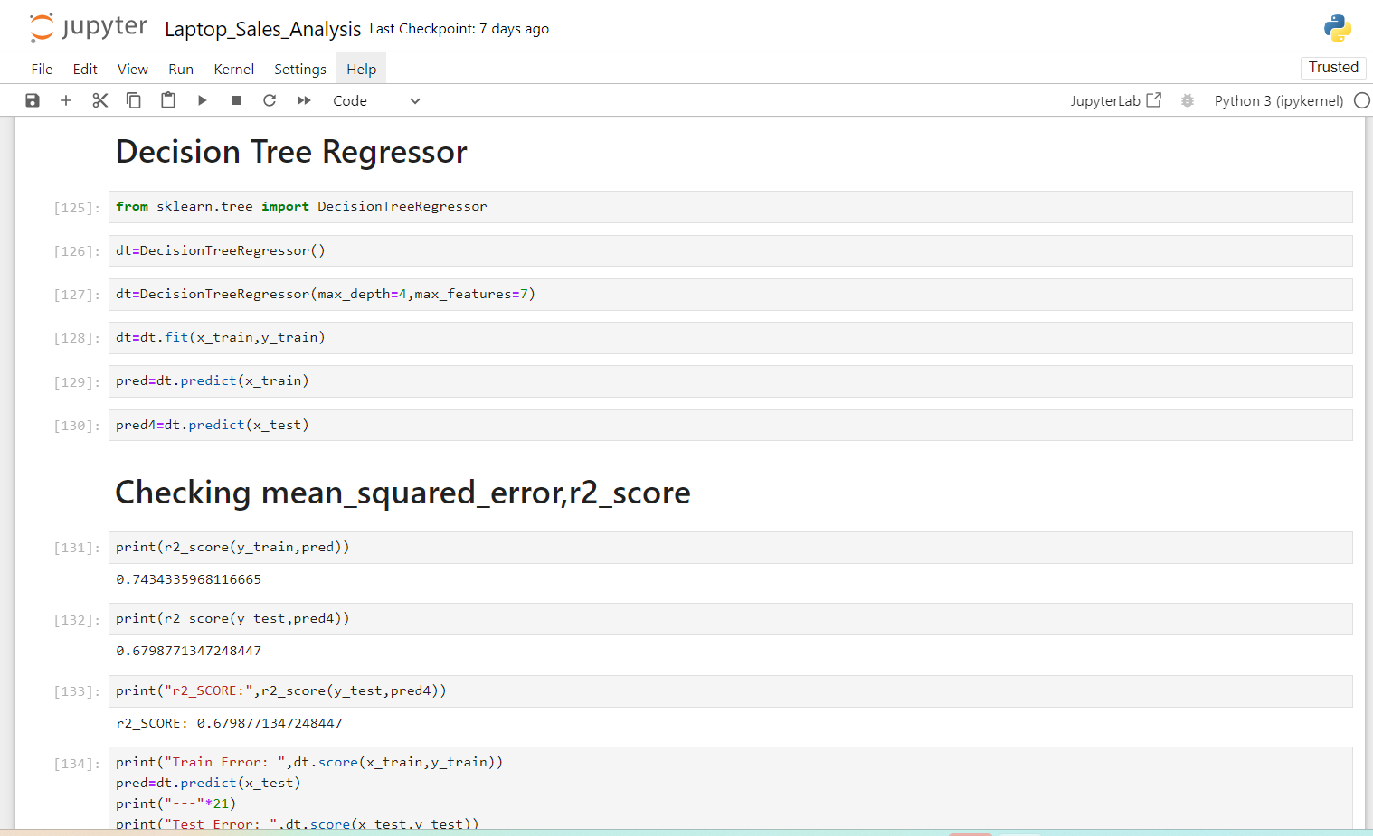
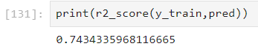
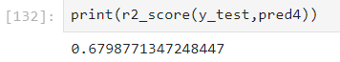
DECISSION TREE GRESSIOR
TRANING AACURACY
TESTING AACURACY

Slide 18
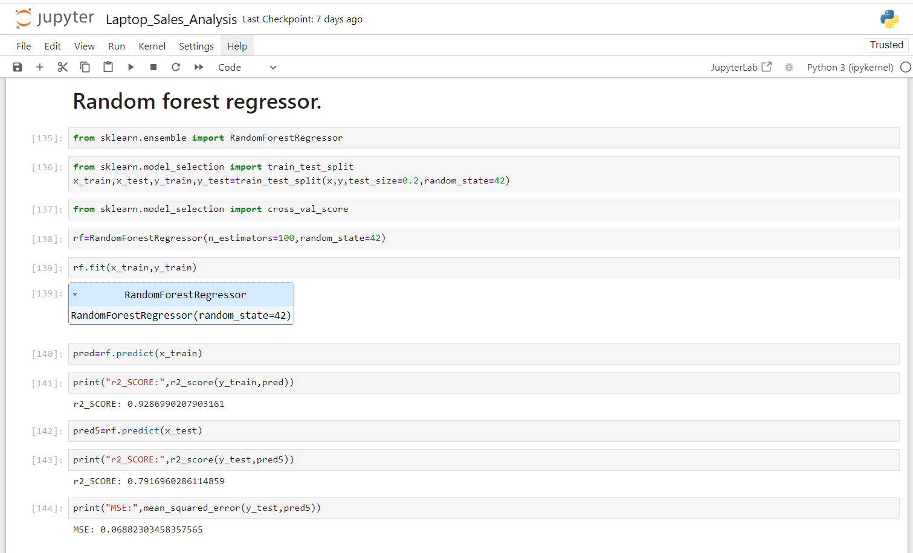
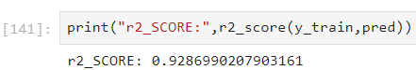
RANDOM FOREST GRESSIOR
TRANING AACURACY
TESTING AACURACY

Slide 19
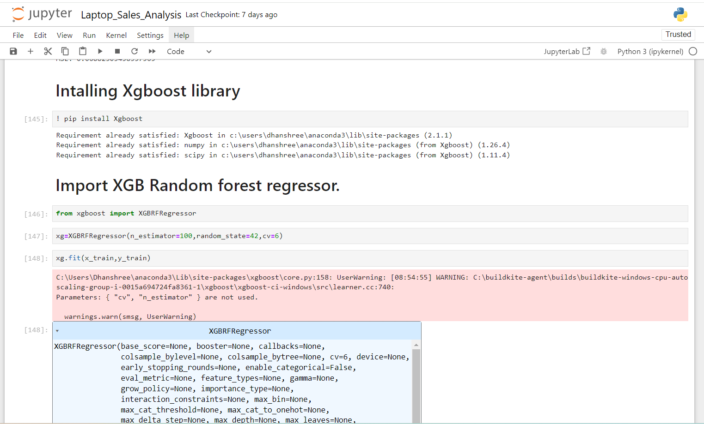
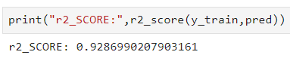
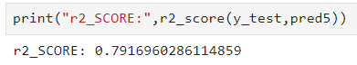
XG BOOST RANDOM FOREST GRESSIOR
TRANING AACURACY
TESTING AACURACY

Slide 20
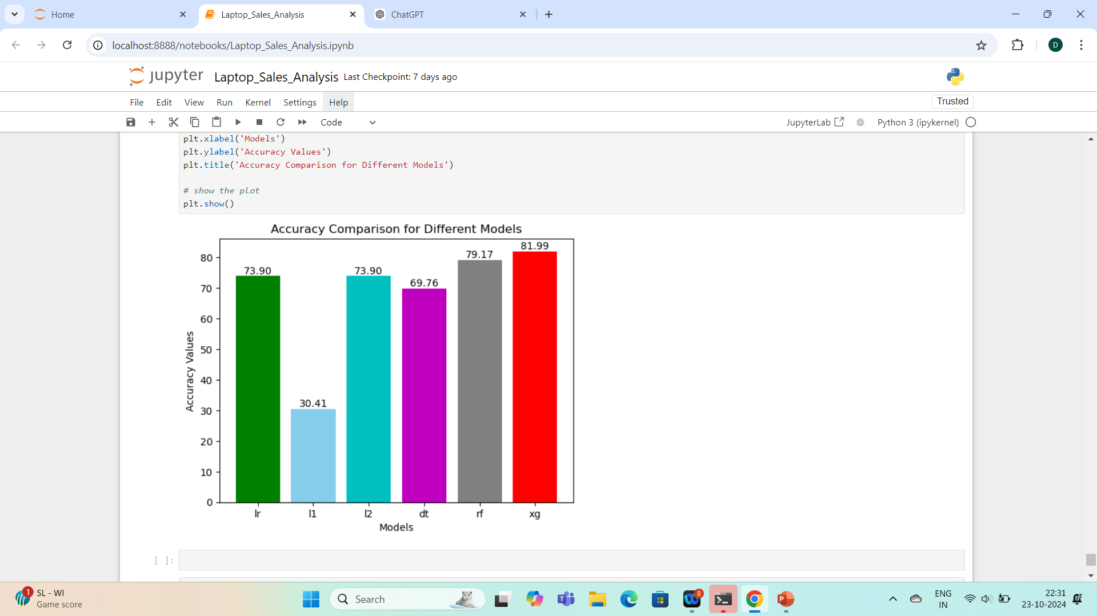
COMPARING ACCURACY

Slide 21
CONCLUSION
The machine learning regression model developed for laptop sales analysis provides valuable
insights into the factors influencing sales performance. By leveraging historical sales data and key
product attributes, the model demonstrates its ability to forecast future sales with a reasonable degree
of accuracy. These predictions can assist businesses in optimizing inventory, refining pricing strategies,
and aligning marketing efforts to maximize profitability. Moreover, the analysis highlights critical trends
and patterns in consumer preferences, enabling more informed decision-making in product
development and distribution. Ultimately, the project underscores the importance of data-driven
approaches in driving business success in the competitive laptop market.

